Slide 1
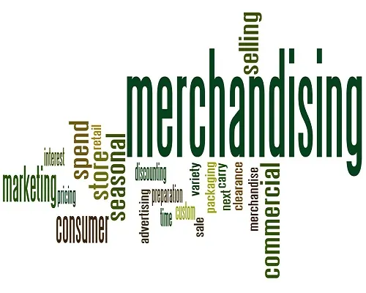

Merchandising and Marketing
(MM Module)
Presented by MIS & SD Department

Slide 2
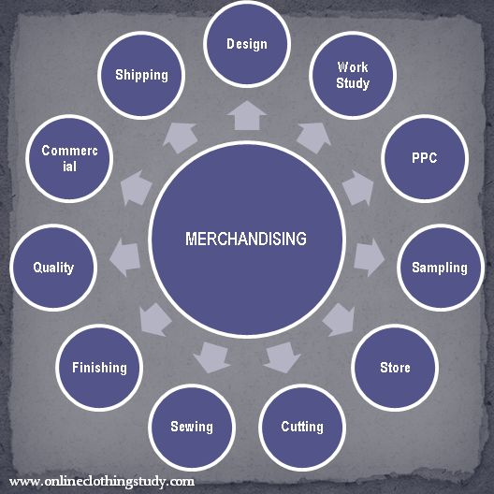
The MASCO Group is embarking on a journey to digitalize its operations by implementing an ERP system.
This Merchandising and Marketing Module (MM Module) specifically aims to enhance the efficient communication and accuracy of the merchandising department.
The new system will allow merchandisers to set product orders with size-wise and color-wise breakdowns, along with several booking formats.

Slide 3


Goals & Objectives
Develop a Merchandising and Marketing Module (MM Module) that enables merchandisers to set product order quantities by color and size and make different bookings i.e. fabric, trims, embellishments etc.
Integrate the new system seamlessly with existing operations.
Ensure the system is user-friendly for easy adoption by merchandisers.
Train merchandisers for appropriate use of the system.

Slide 4
Process | Outcomes
Job Creation | Unique Job
Color & Size wise Breakdown | Single Point Entry
Fabric Booking | Collaboration with Knitting & Dyeing
Trims & Access. Booking | Collaboration with Store, Garments, Accounts & Commercial
Print & Embo. Booking | Collaboration with Print & Embo.
AOP Booking | Collaboration with AOP
Wash Booking | Collaboration with Wash
Payment Acceptance | Collaboration with Accounts & Commercial
Close the Job | Job, Style, Order wise tracking.
Real-Time T&A Visualization

Slide 5
Outcomes
Real-time Tracking
Demand Forecasting
Inventory Control
Buyer Management
Supplier Management
Increase Data Accuracy
Enhanced Supply Chain Management
Reduce Monotonous Data Entry
Easy to Preserve Historical Data
Data-driven Decision-Making
Enhanced Inter-dept. Collaboration
Resources Optimization

Slide 6
Stakeholders & Roles
Stakeholders | Roles
Senior Management | Project sponsorship and facilitate stakeholder engagement.
Merchandising Department | End-users who provide feedback and requirements.
MIS & SD Department | Develops and implements the ERP system.
IT Department | Ensures technical infrastructure and support.

Slide 7
Scope
1
2
System Development
System Integration
Develop a Merchandising & Marketing Module (MM Module) system
Integrate the new Merchandising & Marketing Module (MM Module) with the production module.
Train merchandisers to ensure effective use of the new system.
Offer ongoing technical support and regular maintenance.
User Training
Support and Maintenance
3
4

Slide 8
Deliverables
1
Merchandising & Marketing Module (MM Module) system that facilitates Job creation, size-wise and color-wise breakdown of product orders, Yarn, Fabrics, Embellishment, AOP, Trims & Accessories booking.
2
Training materials for merchandisers.
3
Comprehensive user manuals and documentation.

Slide 9
Milestones
Mile-stones
Status
Job Creation Through System
Completed
Color-Wise & Size-Wise PO booking
Completed
Fabric Booking
Completed
Yarn Booking
In Progress
Print & Embroidery Booking
Completed
Common Accessories Booking
Completed
Order Wise Accessories Booking (Non-portal)
Completed
Order Wise Accessories Booking (Portal)
In Progress
Buyer/Style/Order Wise T&A Set
Completed

Slide 10
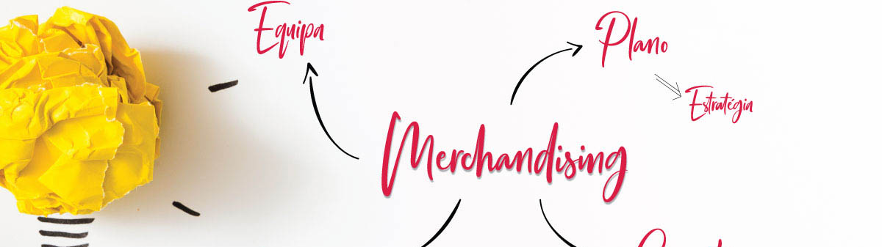

Action Plans

Slide 11
Action Plan
1
Start the project in live.
2
Identify the bugs and issues during implementation.
3
Fix the bugs and issues as soon as possible.
4
Collaborate on demand function.
5
Enhancing user experience via training and development.
6
Weekly review meeting with each Merchandising team.
7
Generate operational report and dashboard as required.

Slide 12

Thank You!

